Slide 1
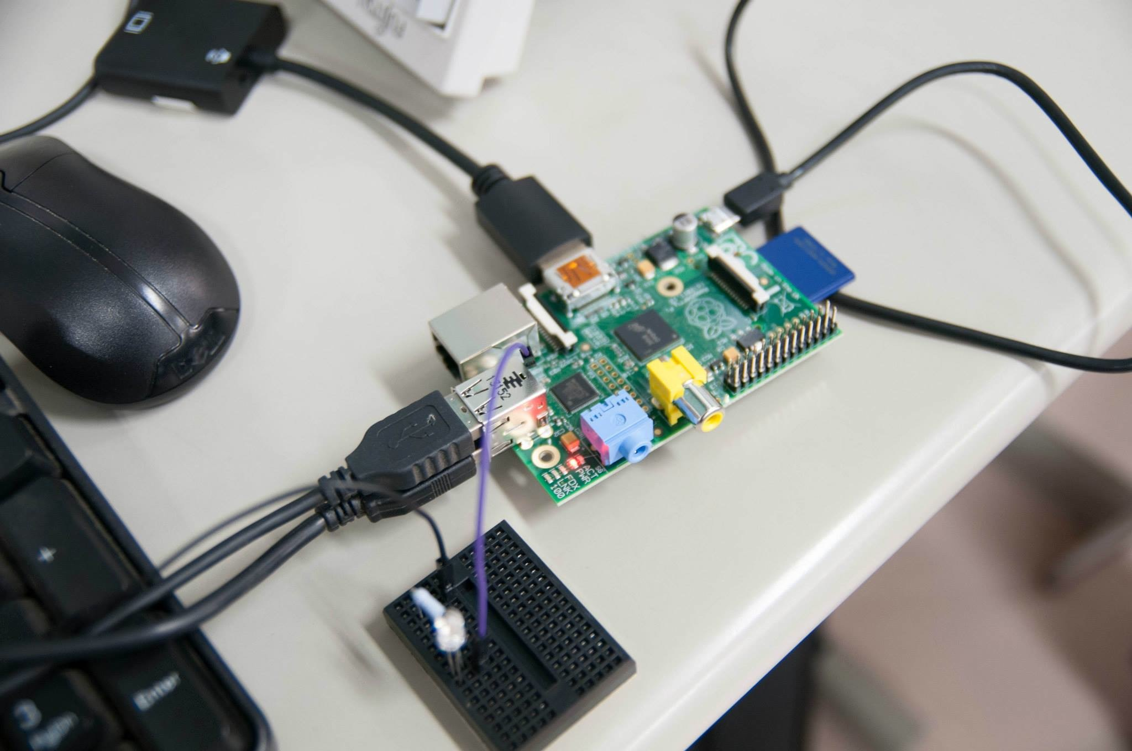
Scratch + Raspberry Pi Workshop: Control LED Lights by Programming
2014/04/17(Sun)
Yohei Yasukawa
@YasuLab

Slide 2
Note for Instructors
These slides were used in the 1.5 hour workshop, held at Yokohama International School.
If you’d like to have this workshop, you will need to prepare the following things/software:
Get a Raspberry Pi and stuffs to boot it: Display, keyboard, mouse, cables, etc.
Download and install Scratch GPIO4.
Buy a breadboard and circuit elements.
* For details, see References on the last slide.

Slide 3
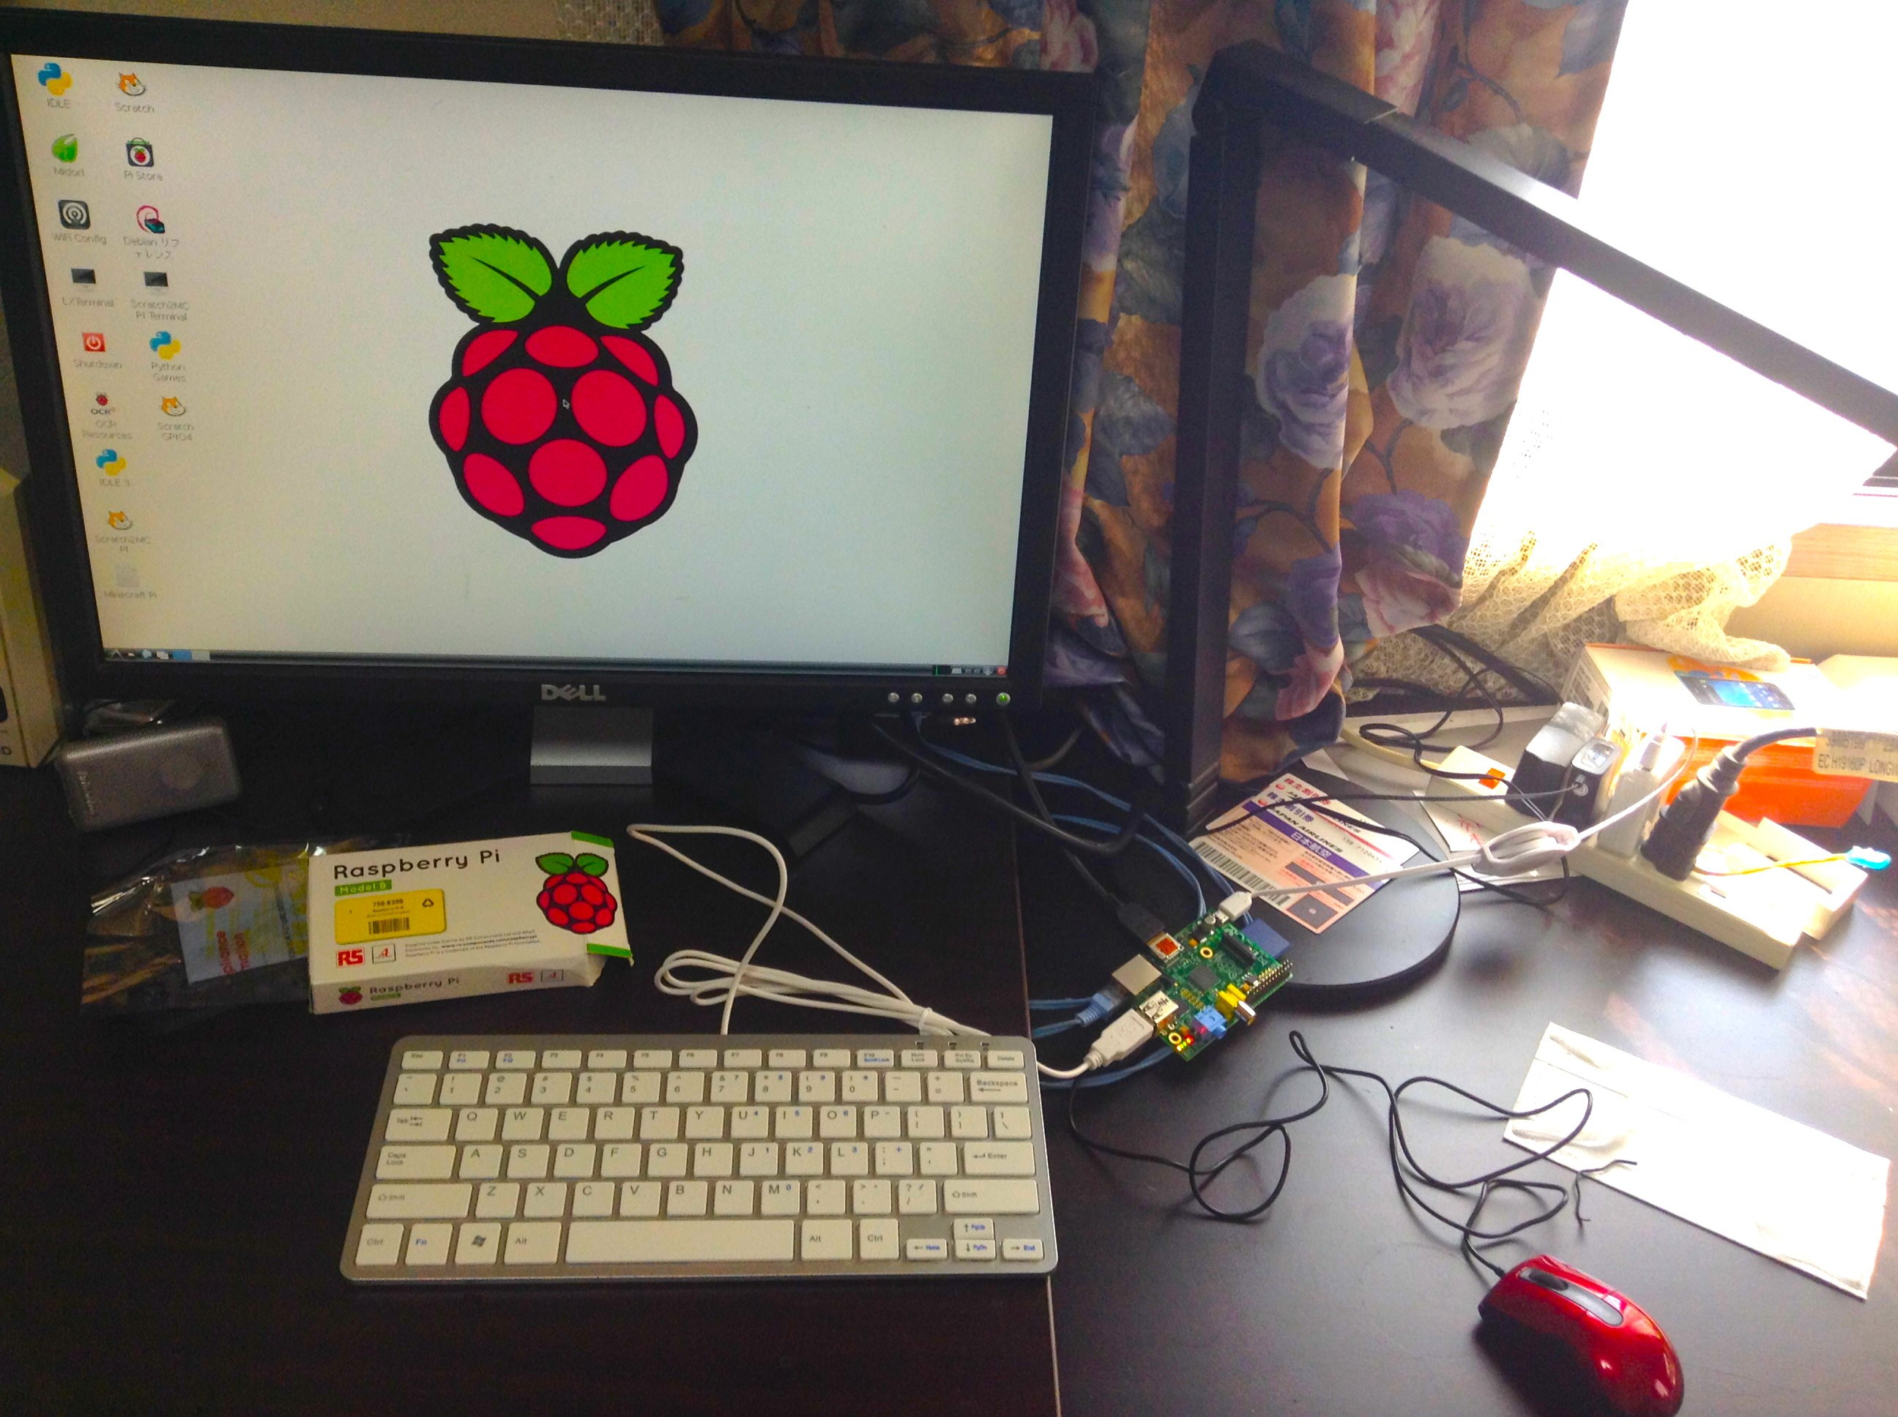
Hands-on: Let’s set up Raspberry Pi!
1. HDMI Display
2. Raspberry Pi
(Type-B)
3. USB Keyboard & USB Mouse

Slide 4
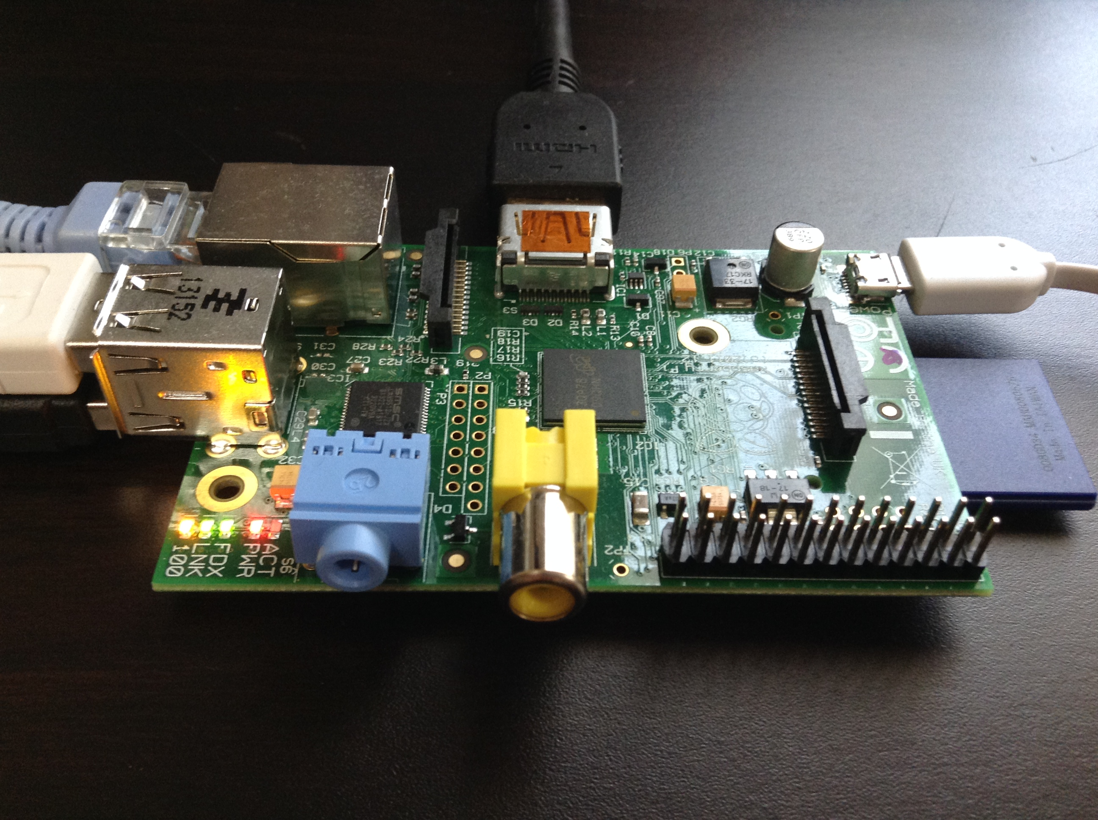

Ethernet
to access Web (option)
HDMI
to display
USB Mini
to power
2 USBs for keyboard
& mouse
Ports we’ll use in this workshop
SD Card (on the back) to boot
Pins for prototyping

Slide 5
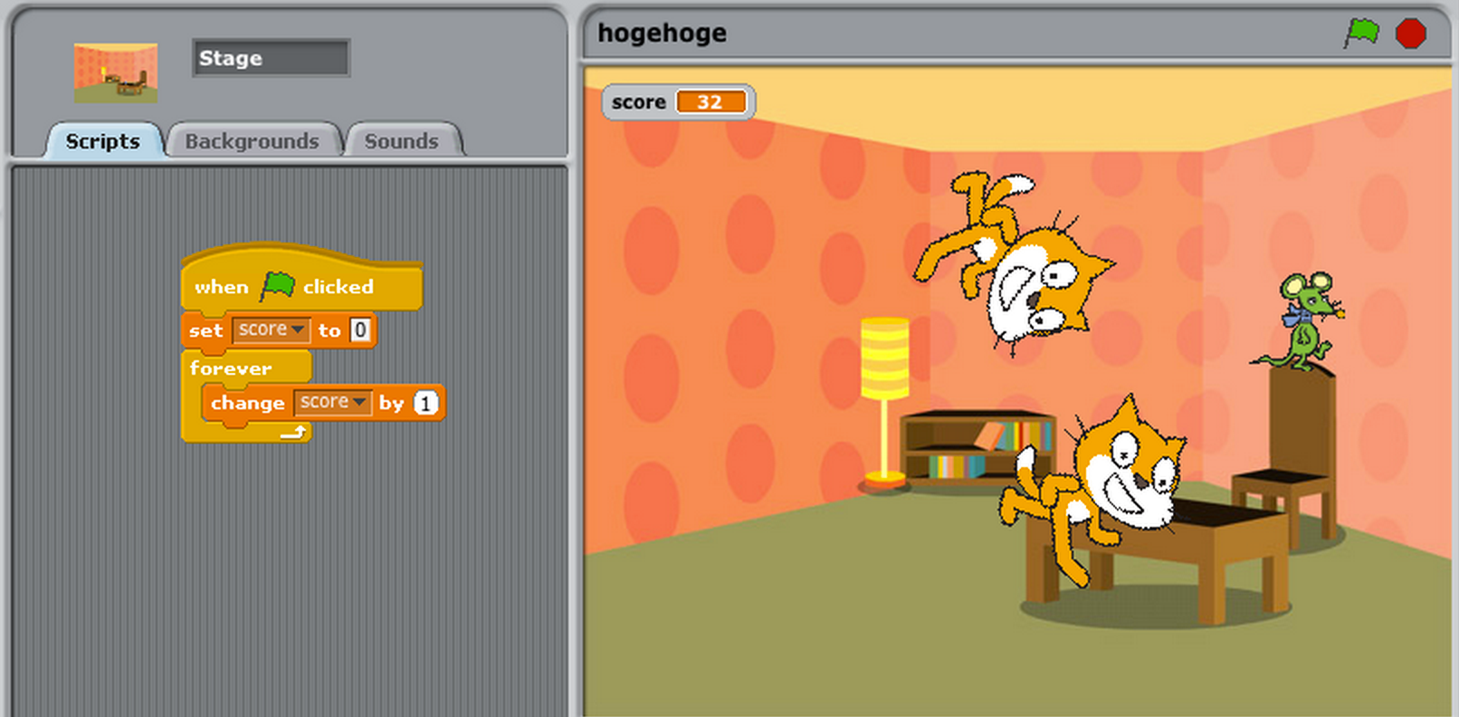
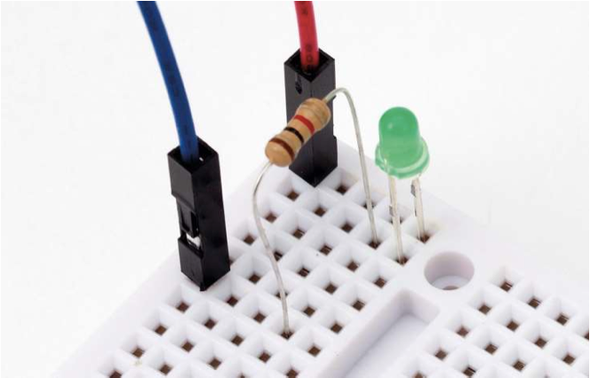
Summary
Make a program with Scratch
Control LED with Raspberry Pi

Slide 6
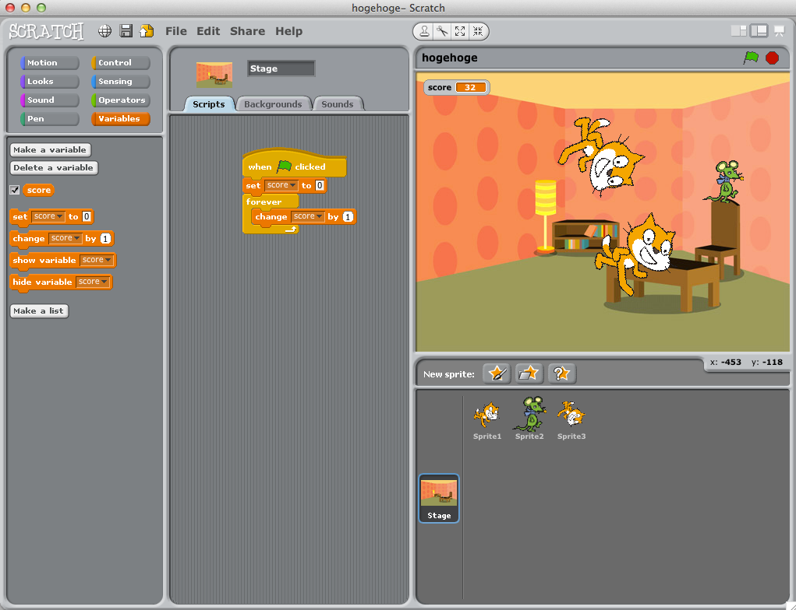

Making a program with Scratch is really easy. You can run Scratch by double-clicking this icon on Desktop:

Slide 7
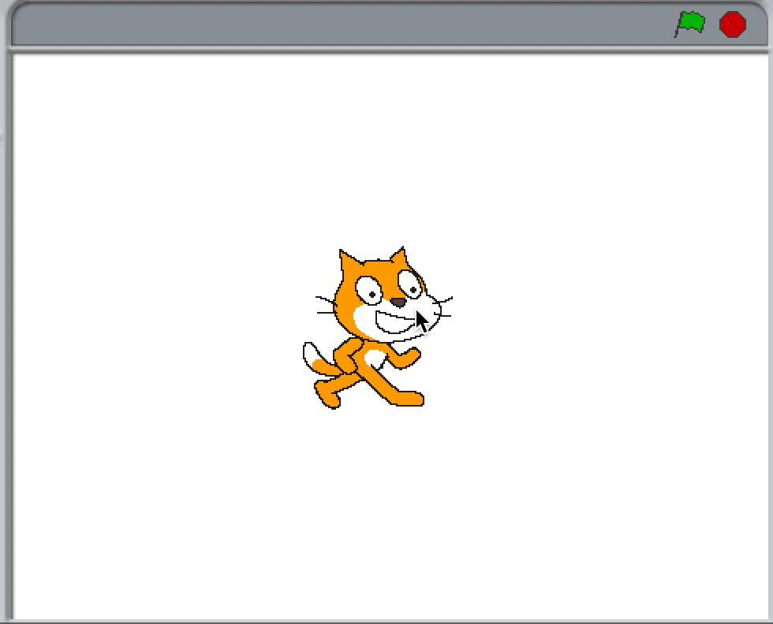
Hands-on: Walking Cat

Slide 8
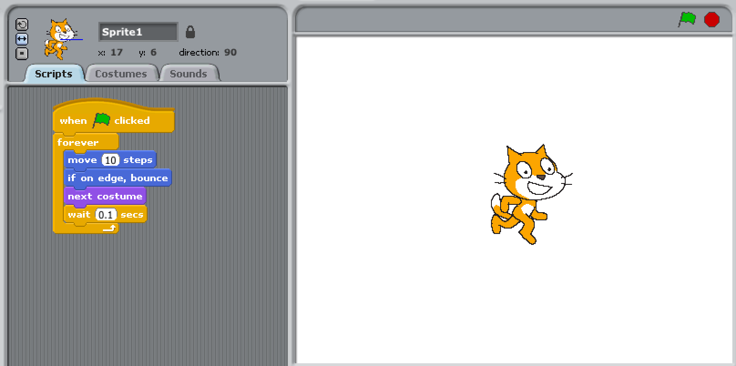
Hands-on: Walking Cat
This is one of answers that makes a cat walk.

Slide 9
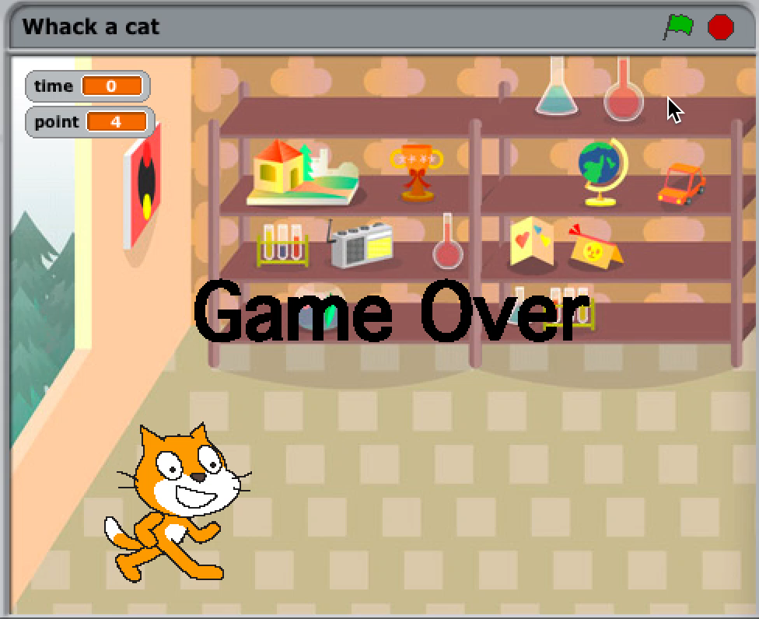
Other Sample: Whack a Cat

Slide 10
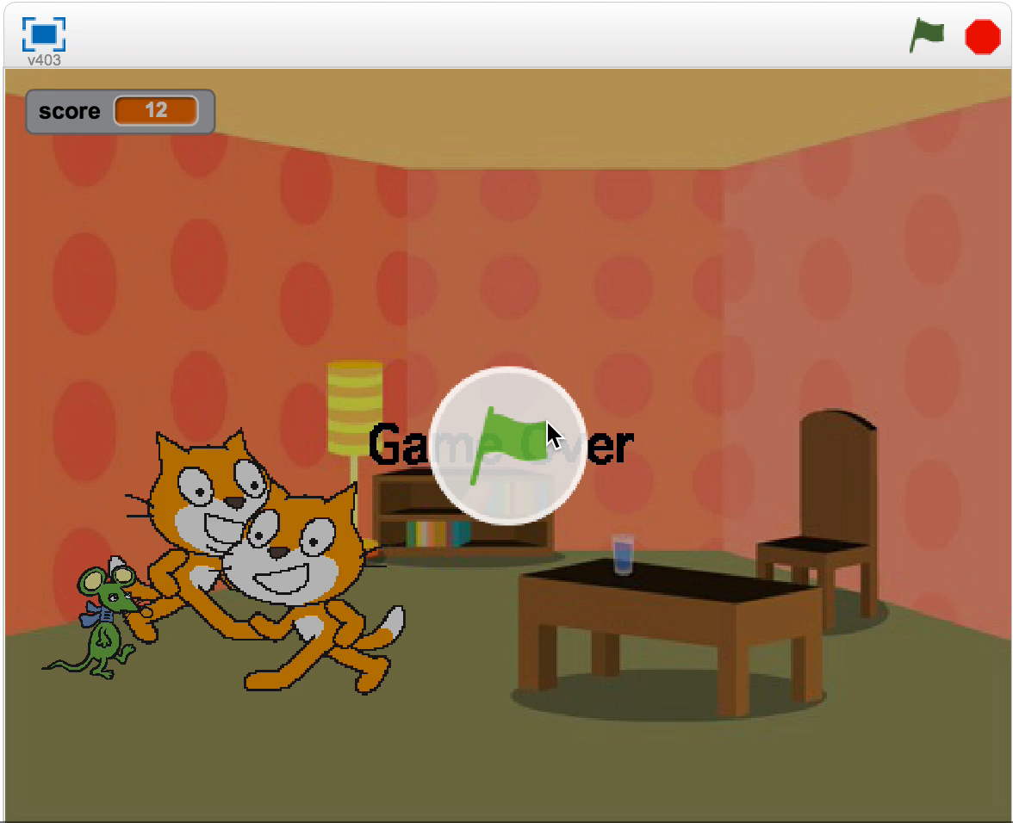
Other Sample: Escape from Cat

Slide 11

Summary
Make a program with Scratch
Control LED with Raspberry Pi

Slide 12
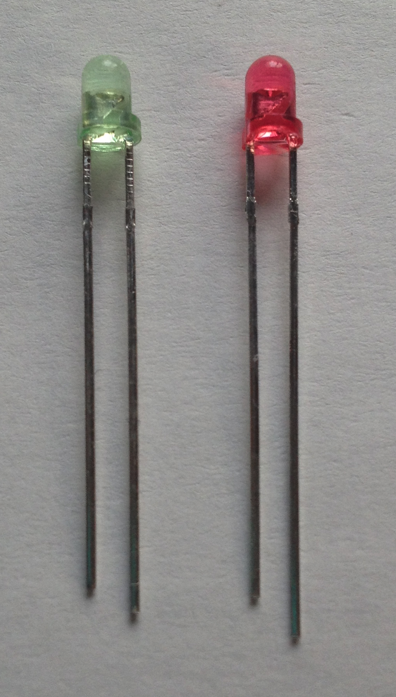
LED: Light Emitting Diode
The length is different.
• Shorter is negative.
• Longer is positive.
Cathode
(negative)
Anode
(positive)

Slide 13
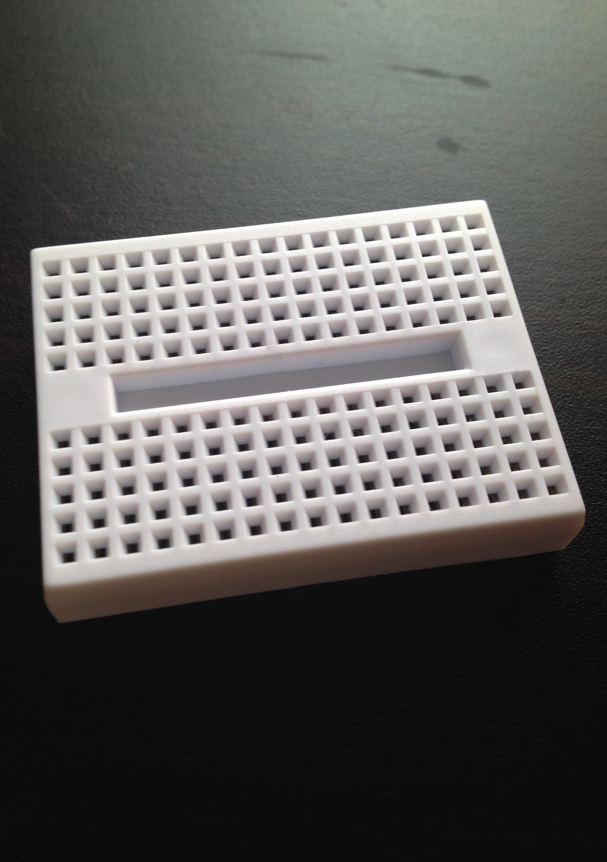
Breadboard
is usually a construction base for prototyping of electronics. The term "breadboard" is commonly used to refer to a solderless breadboard. cf. http://en.wikipedia.org/wiki/Breadboard

Slide 14
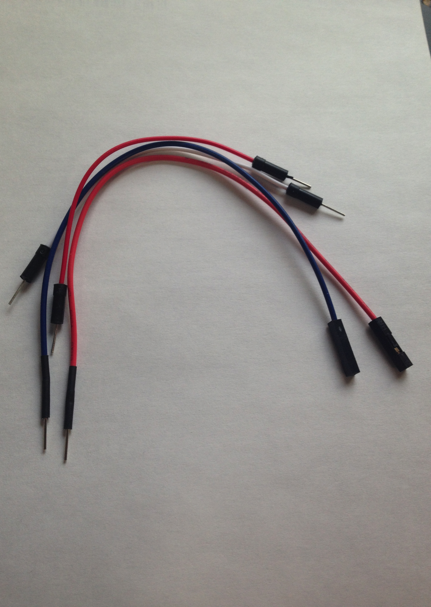
Jumper Wire
There are two types for connecting between:
1. Raspberry Pi and Breadboard
2. Breadboard and Breadboard
* You don’t have to care about it’s color.

Slide 15
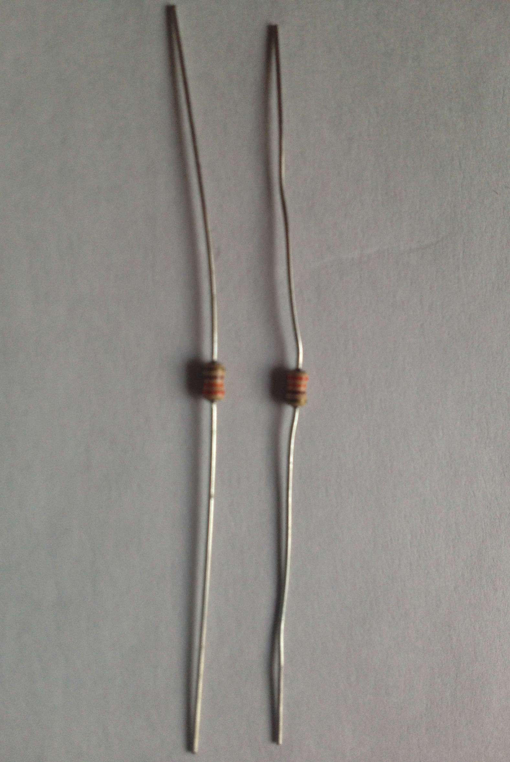
Resistor
is an electronic element to control current to LED
Bend a resistor ‘C’ shape to wire it into your breadboard.

Slide 16
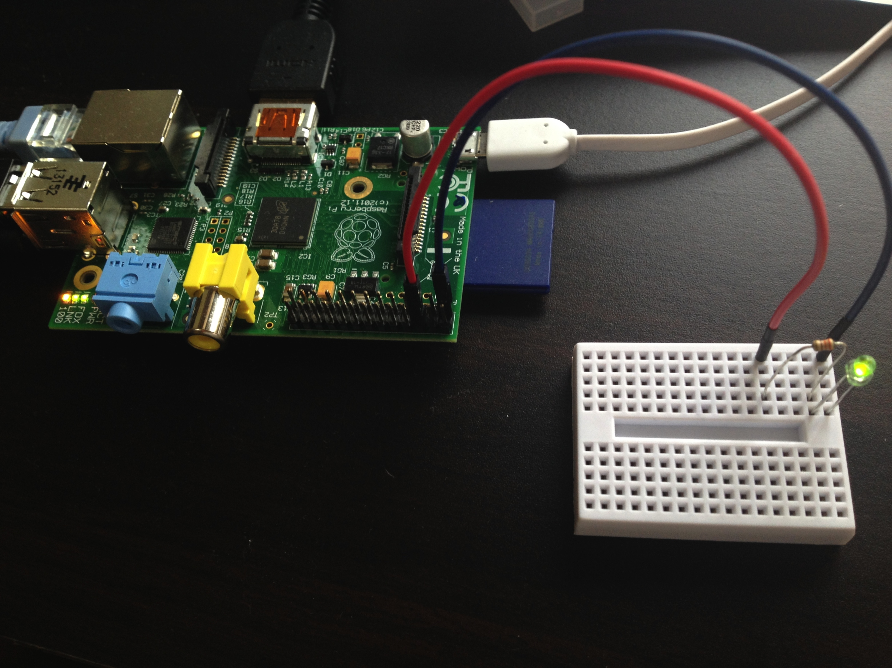
Hands-on: Control LED w/ RP
1). Build a LED circuit on a breadboard, 2). connect it to Raspberry Pi’s GPIO, and 3). control LED light from Scratch.

Slide 17
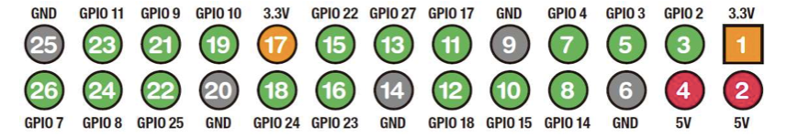
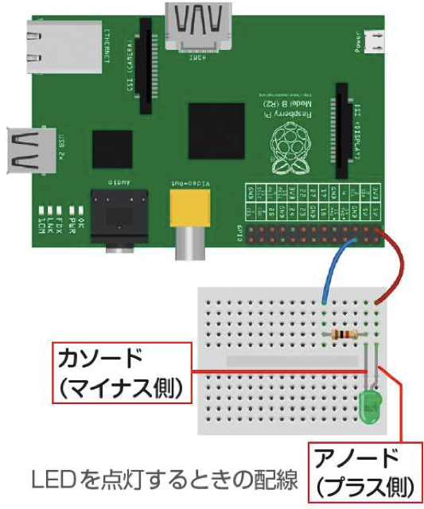
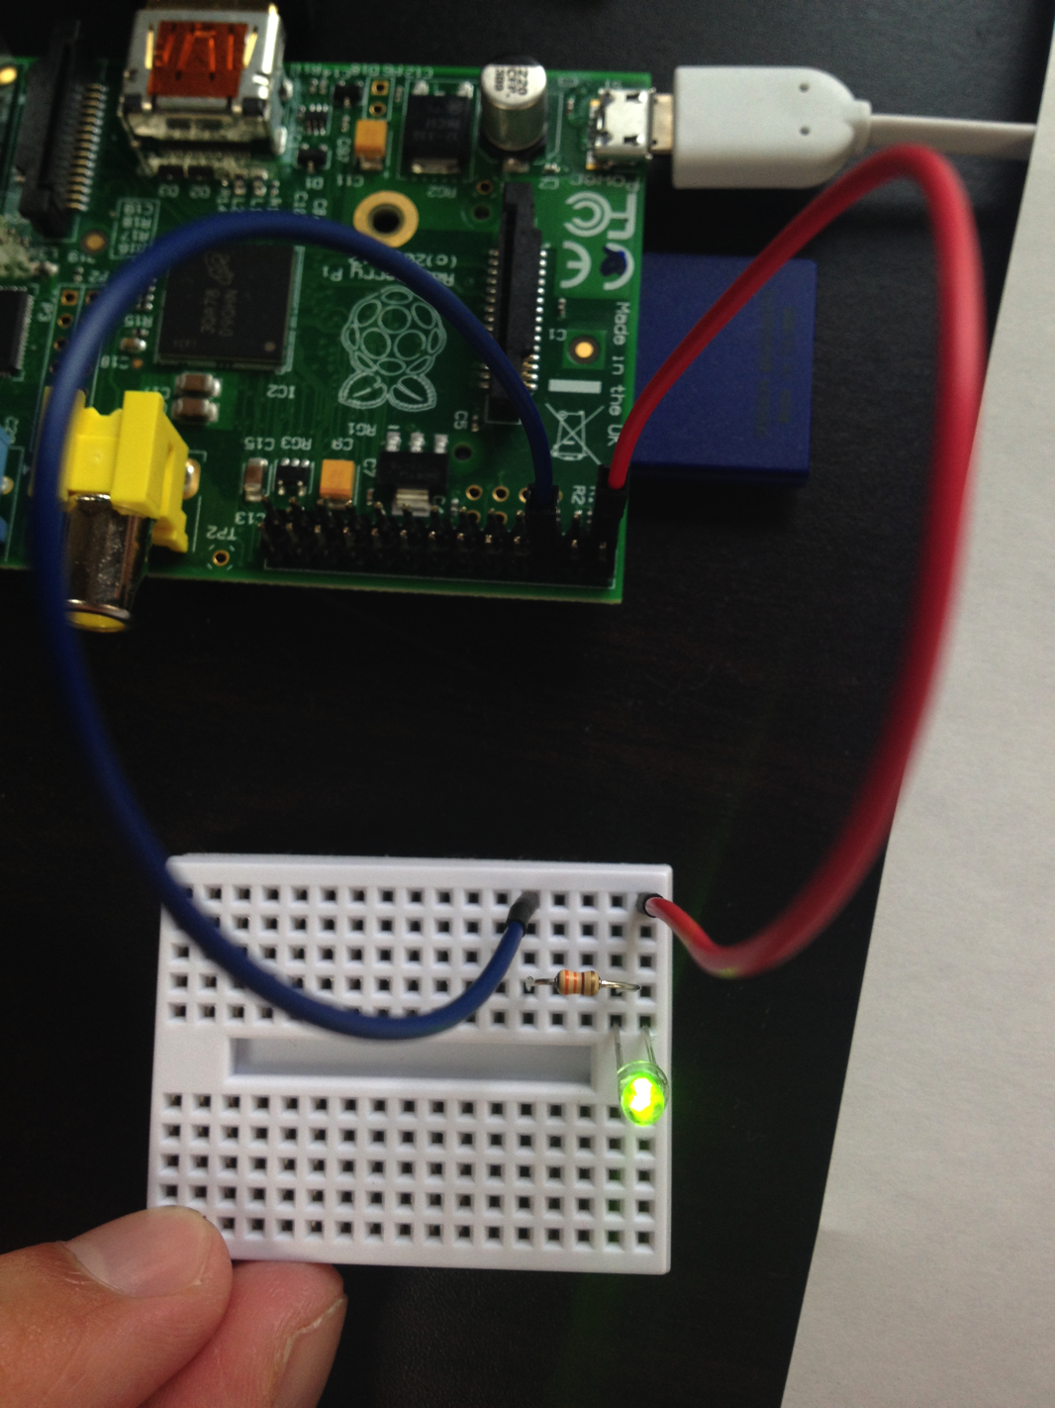
1). Build a LED circuit on a breadboard
Cathode
(shorter)
Anode
(longer)

Slide 18
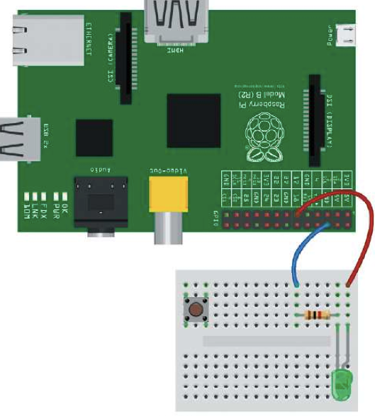
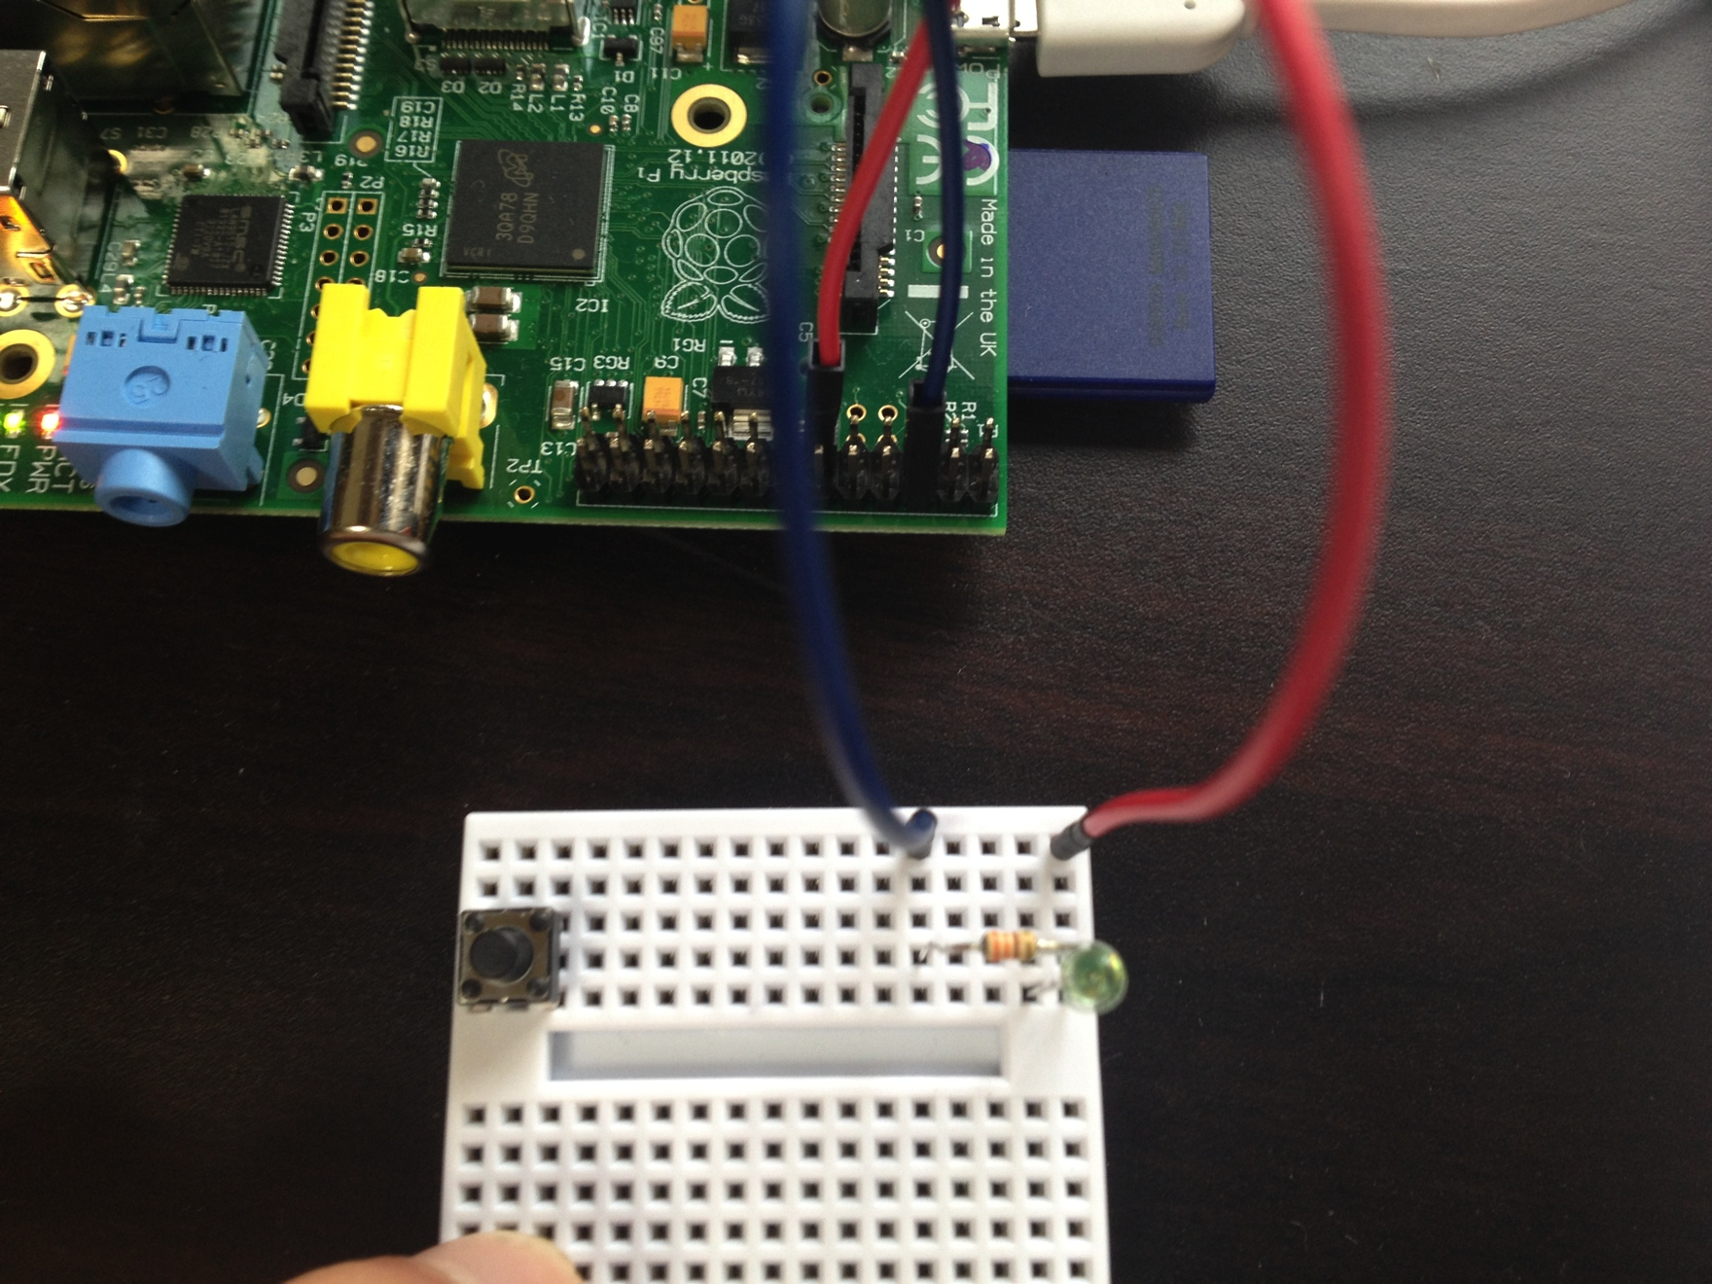
2). Connect it to Raspberry Pi’s GPIO

Slide 19
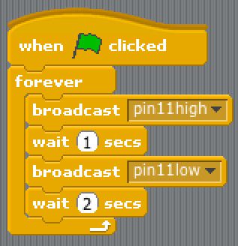


3). Control LED light from Scratch
1. Close Scratch window.
2. Open Scratch GPIO4.
3. File -> Open blink11.
4. Click the green flag.

Slide 20
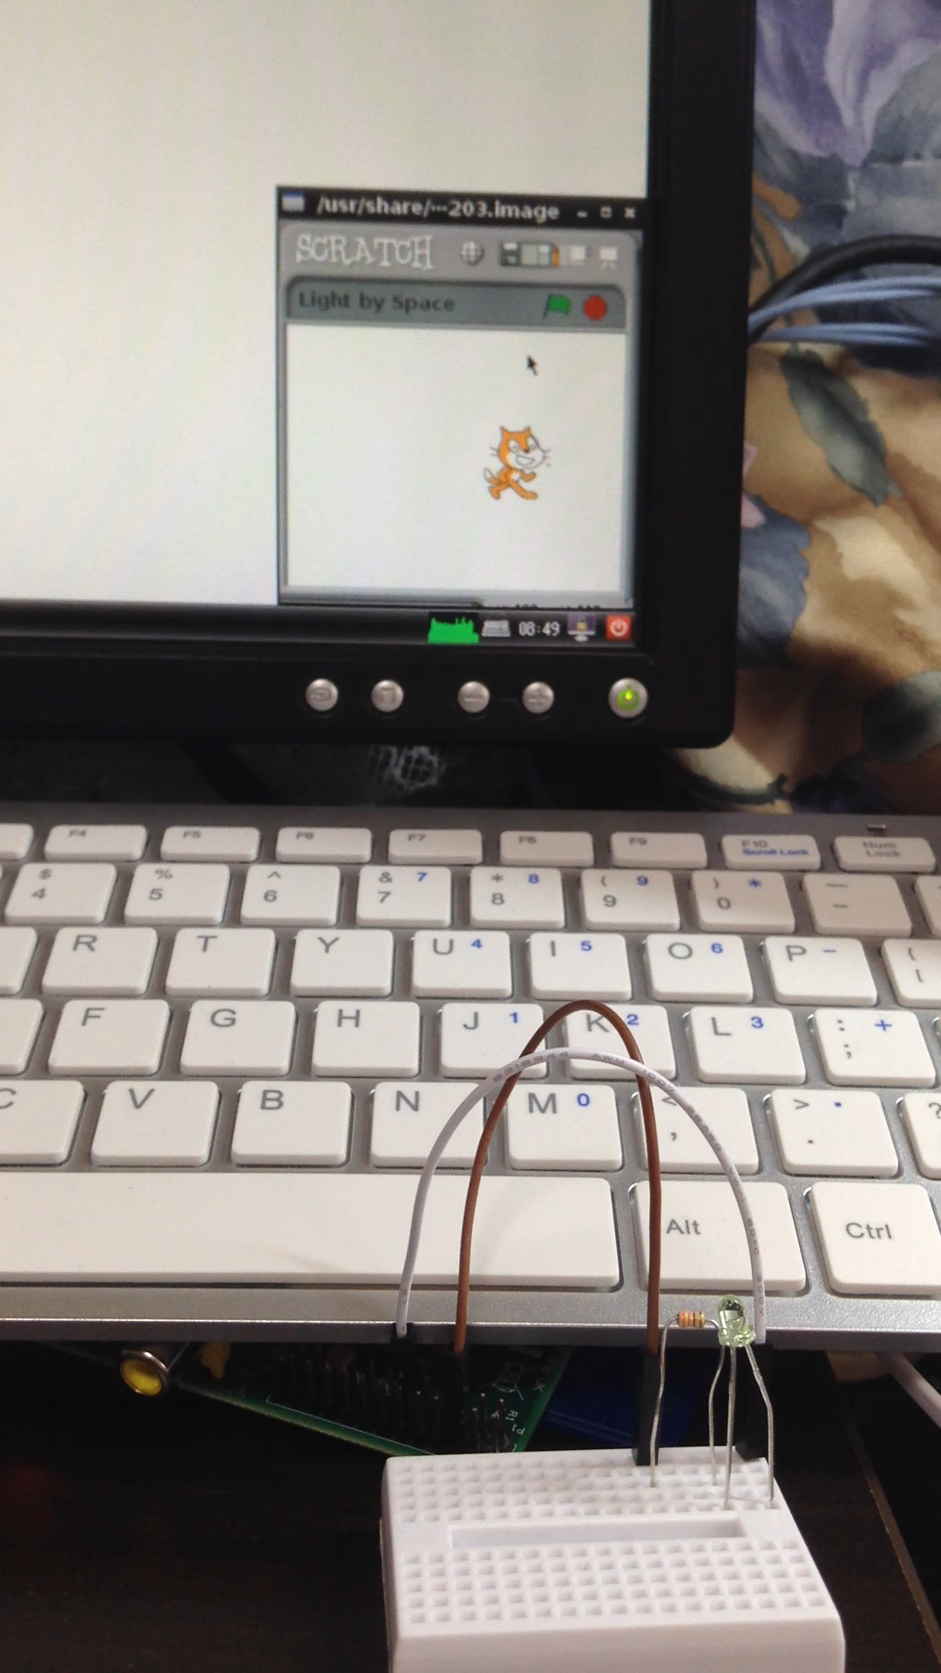
Hands-on: Light by Space
• Create a script that turns on LED light while pressing Space on your keyboard.
• If not pressing Space, LED light should be off.
• Hint: Some block in Sensing may be helpful.

Slide 21
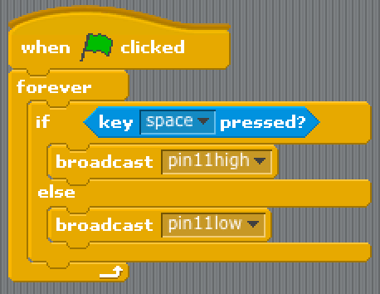
Hands-on: Light by Space
Sample Answer:

Slide 22
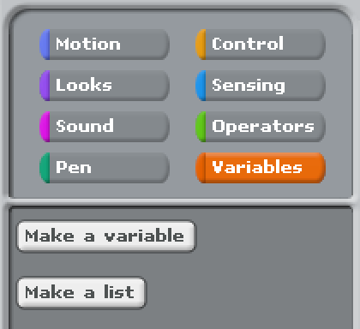
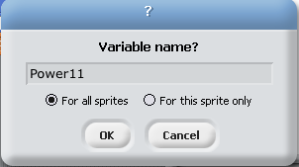


Control from 0/1 to 0~1
Let’s control brightness of LED light by using Variables (orange block).
Go to Variables, and click Make a variable.
Name it Power11, and click OK.
Double click Power11 appeared at the top left in the stage.
Change the number by dragging the slider next of Power11.

Slide 23
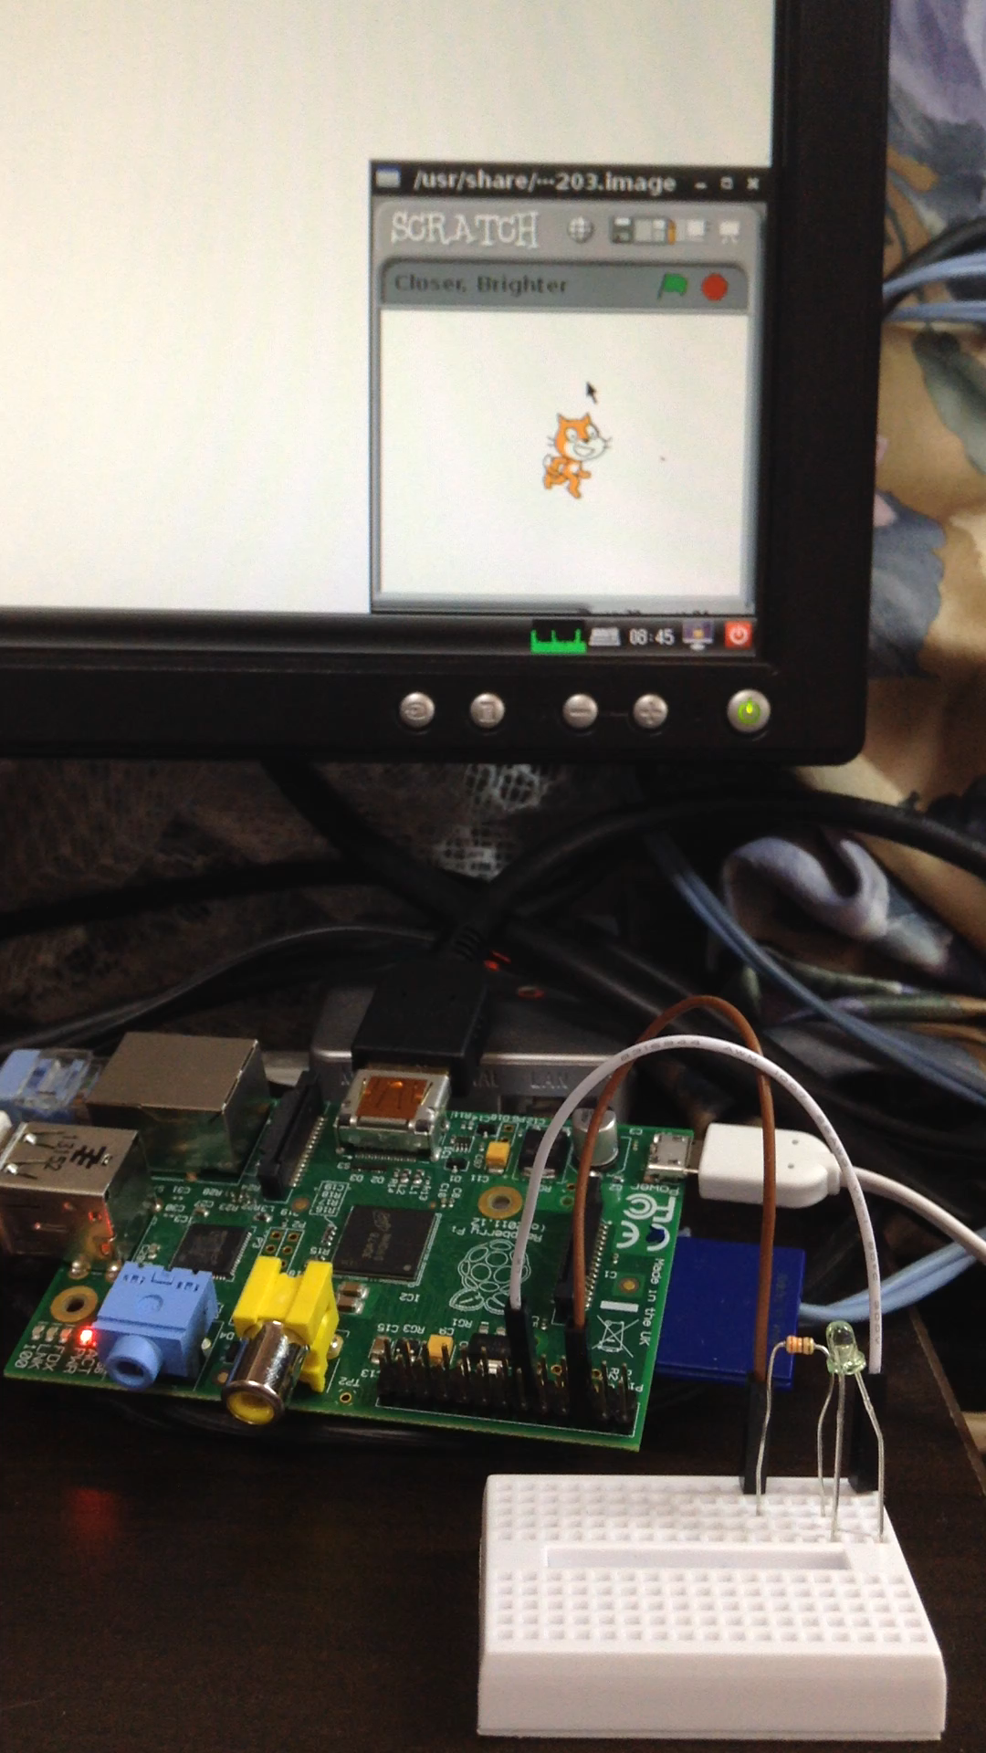




Final Hands-on: Closer to edges, Brighter the light
When a cat moves to right/left and it’s closer to edges, change the LED light brighter.
Hint: You may need to know the position of Cat by using some block(s) in Motion.
Closer to the side edges,
then brighter the light.

Slide 24
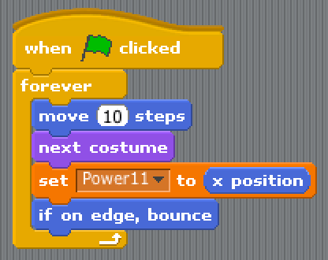
Final Hands-on: Closer to edges, Brighter the light
Sample Answer:
Closer to the side edges,
then brighter the light.

Slide 25
Summary
Make a program with Scratch
Control LED with Raspberry Pi

Slide 26
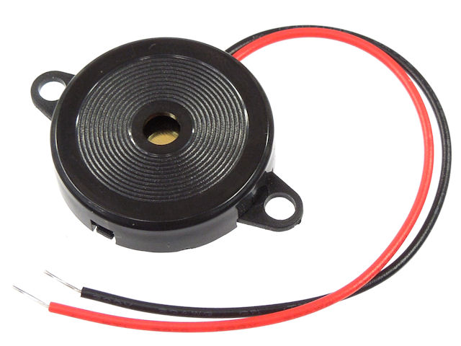
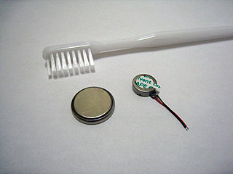
For further topics, you can replace LED light with something like:
Piezoelectric Loudspeaker to control sounds:
Vibrating Motor to vibrate something:

Slide 27
Scratch + Raspberry Pi Workshop: Control LED Lights by Programming
2014/04/17(Sun)
Yohei Yasukawa

Slide 28
References
Raspberry Piではじめる どきどきプログラミング (はじめるプログラミング シリーズ) [単行本] 阿部 和広 (著, 監修), 石原 淳也 (著), 塩野 禎隆 (著): http://www.amazon.co.jp/Raspberry-Piではじめる-どきどきプログラミング-はじめるプログラミング-シリーズ/dp/4822297314 (Available only in Japanese)
PEG (Programming Education Gathering): http://pegpeg.jp/ (Available only in Japanese)
Scratch GPIO version 4 http://cymplecy.wordpress.com/2013/04/22/scratch-gpio-version-2-introduction-for-beginners/ (Available only in English)
Raspberry Pi - Wikipedia: http://en.wikipedia.org/wiki/Raspberry_Pi

